Slide 1
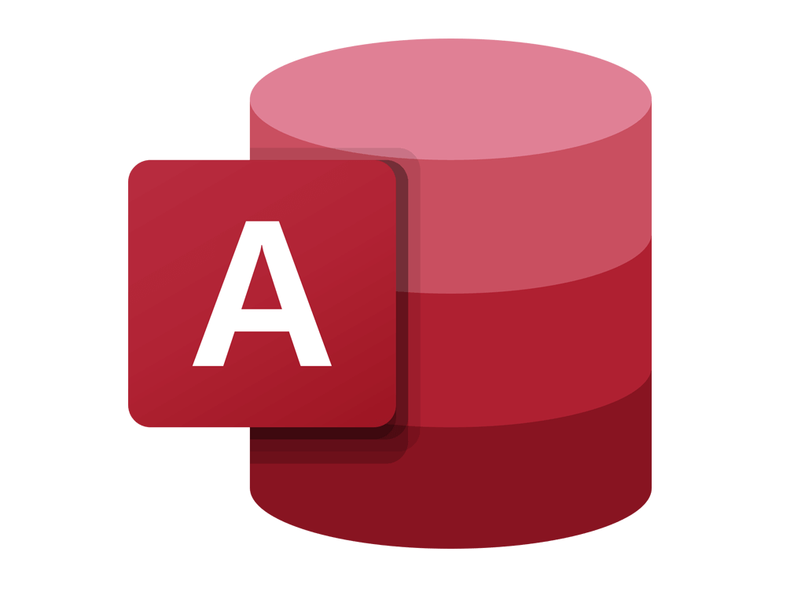

Getting Started With
Microsoft Access
Database
1
Manager of Information Center
Tendering Department
Arab Contractors
Said Fawzy

Slide 2
Getting Started With
Microsoft Access
Database
1
What is a Database
Manager of Information Center
Tendering Department
Arab Contractors
Said Fawzy

Slide 3


Contents
Database concepts.
Database Main Components
Database Users.
Database System Advantages.
Database System Disadvantages.
DBMS Architecture (Three Schema Architecture).
Data Models.
Mappings.
DBMS other Functoions.
DBMS Environment.
Distributed Database
Data and Information.
Database in your daily life.

Slide 4

Data and Information
Process
Data
Information

Slide 5


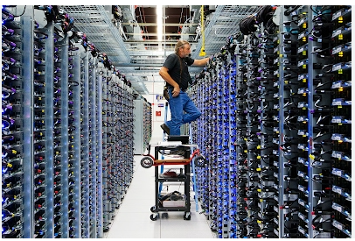

Data Centers
Data centers are estimated to be responsible for up to 3% of global electricity consumption today and are projected to touch 4% by 2030.

Slide 6

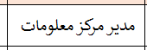
Data and Information
Data
What is the Job of Said Fawzy?
Information

Slide 7
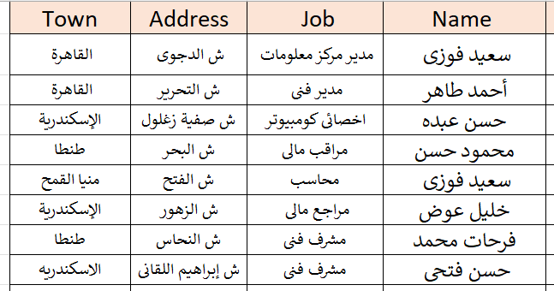
Data and Information
Data
Employees from Alex?
Information

Slide 8
Data and Information
We save Data in Database

Slide 9
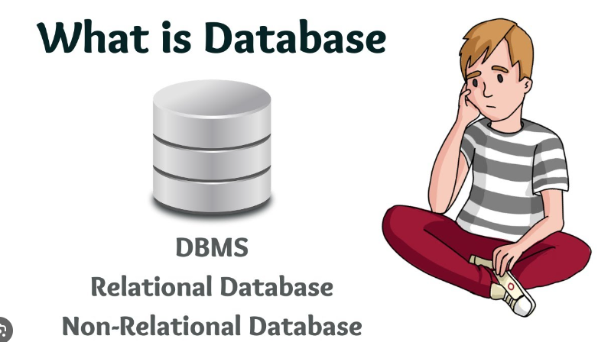

Video

Slide 10
Advantage of Database
Easy to reach information
Fixability to update and retrieve data.
Easy reporting.
Security
Backup
Data Integration.
Easy for Data analysis.
Productivity.
Represent Relationships between data in easy way.

Slide 11
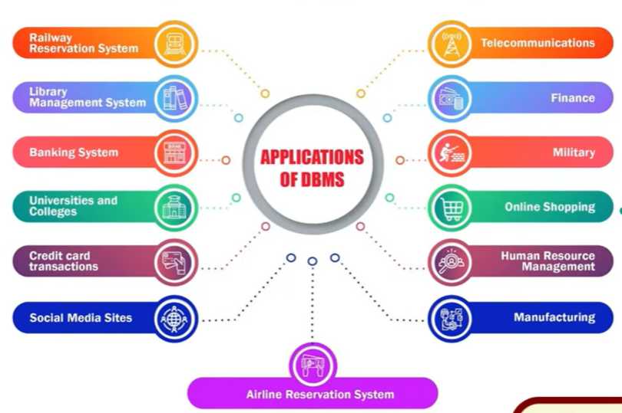

Slide 12

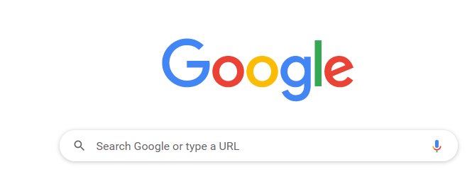
Database in your daily life?
There is always a Database in the Back end

Slide 13
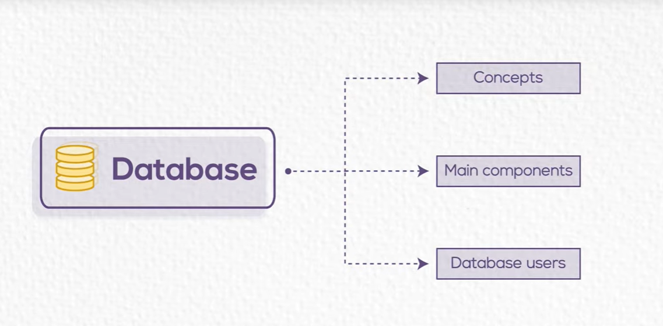
We need to know more about Database

Slide 14

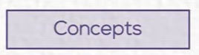

Slide 15
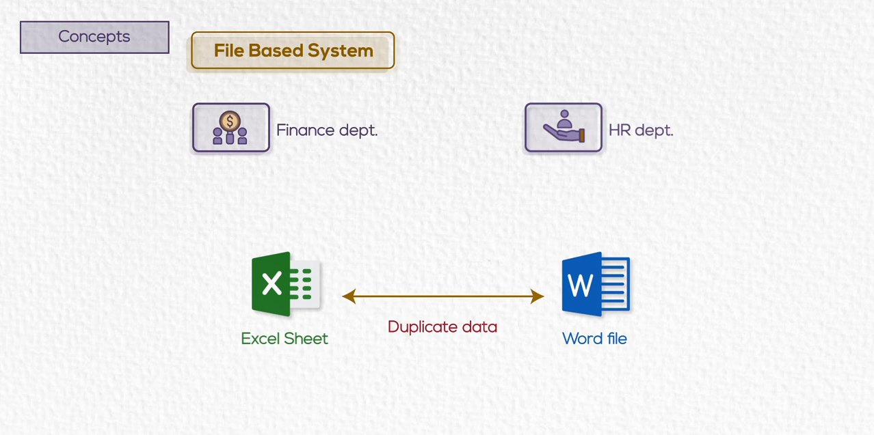
Before Database

Slide 16
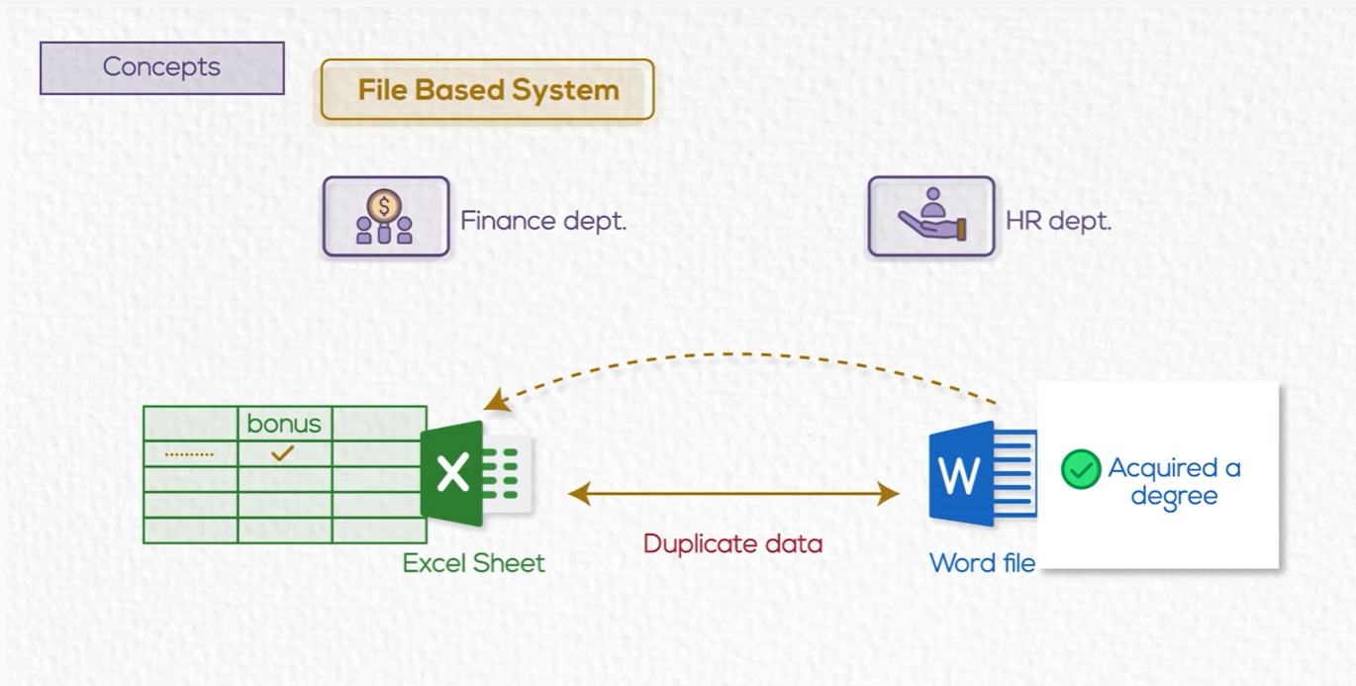
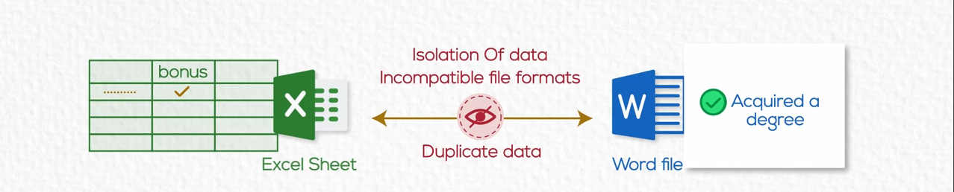
Before Database
An employee acquired a master degree

Slide 17
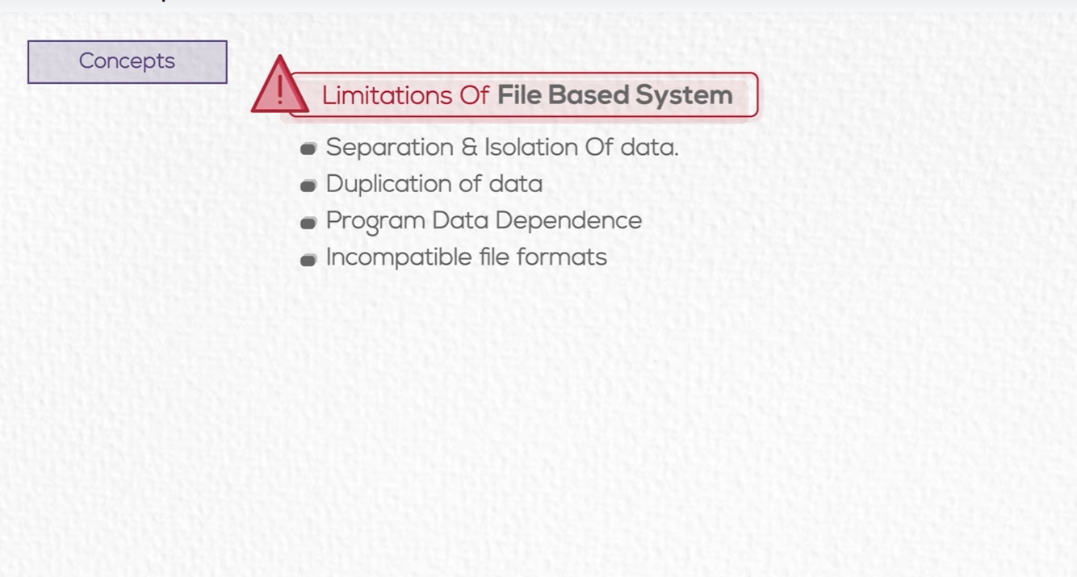
Before Database

Slide 18

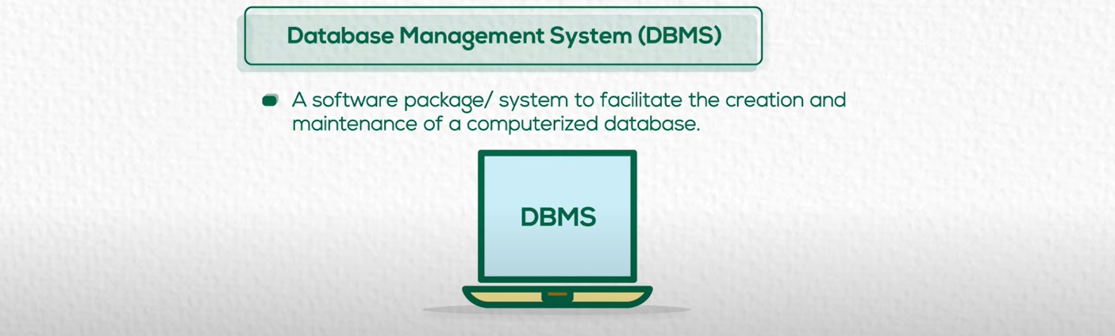

Slide 19
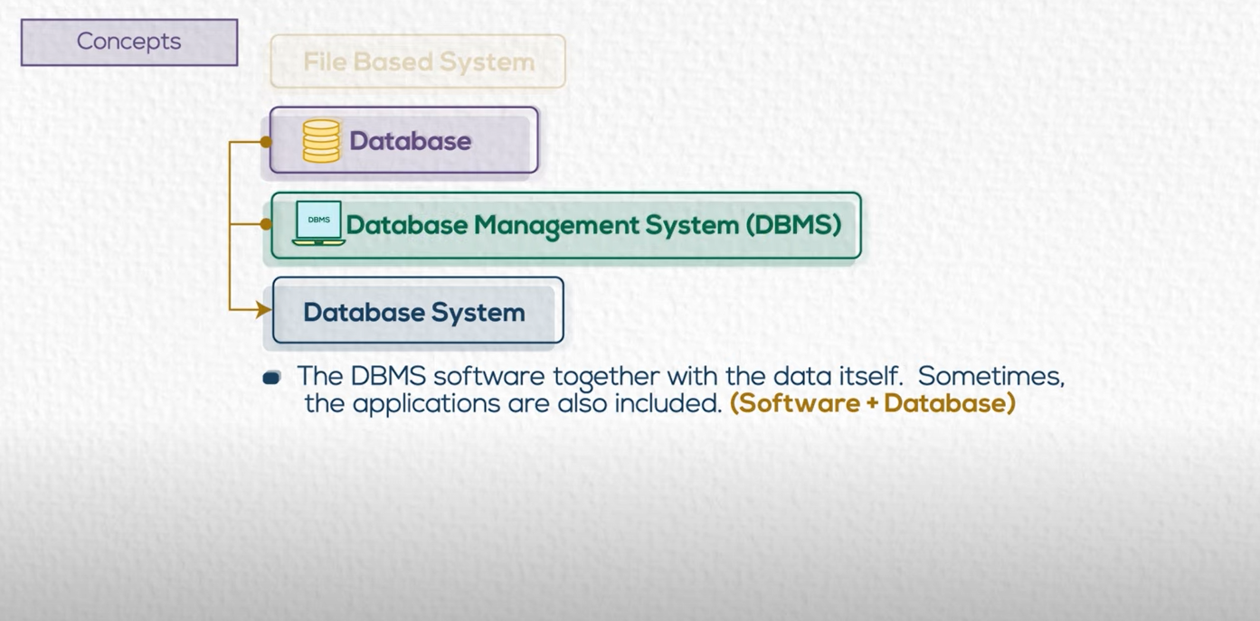

Slide 20


Slide 21
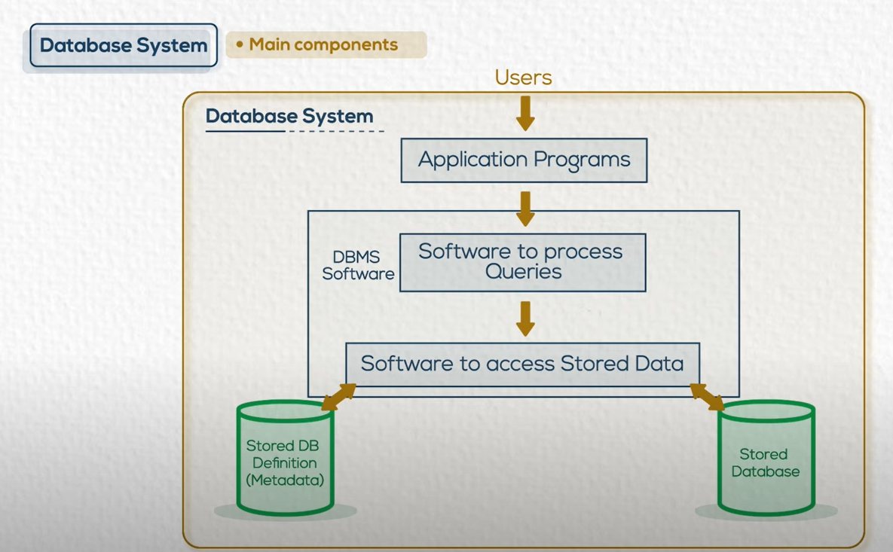

Slide 22
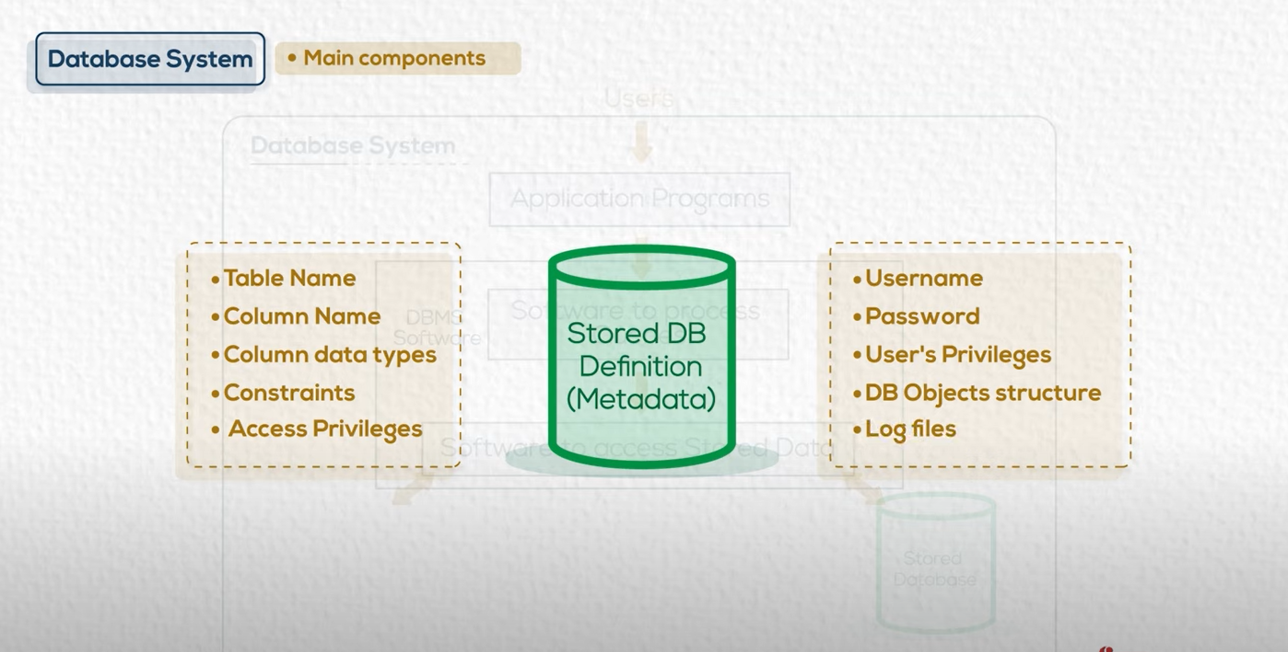


Slide 23
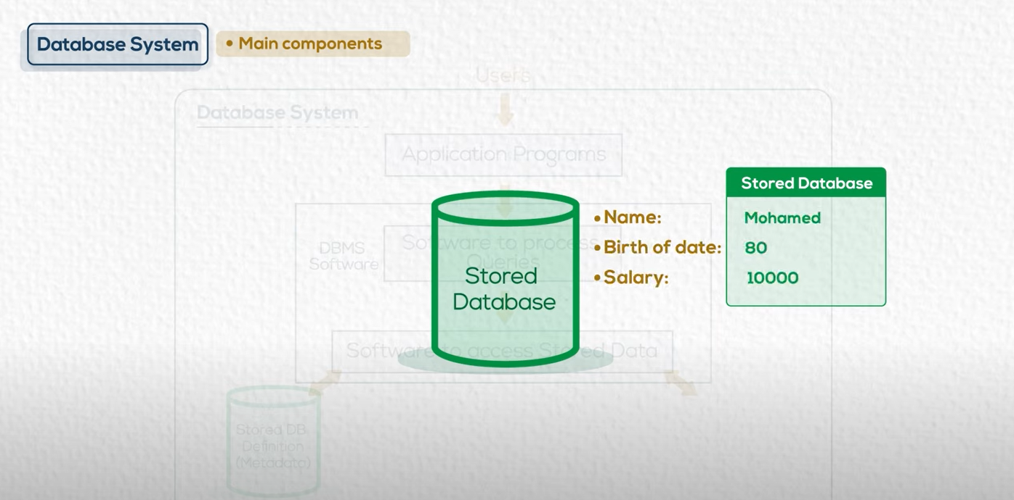

Slide 24
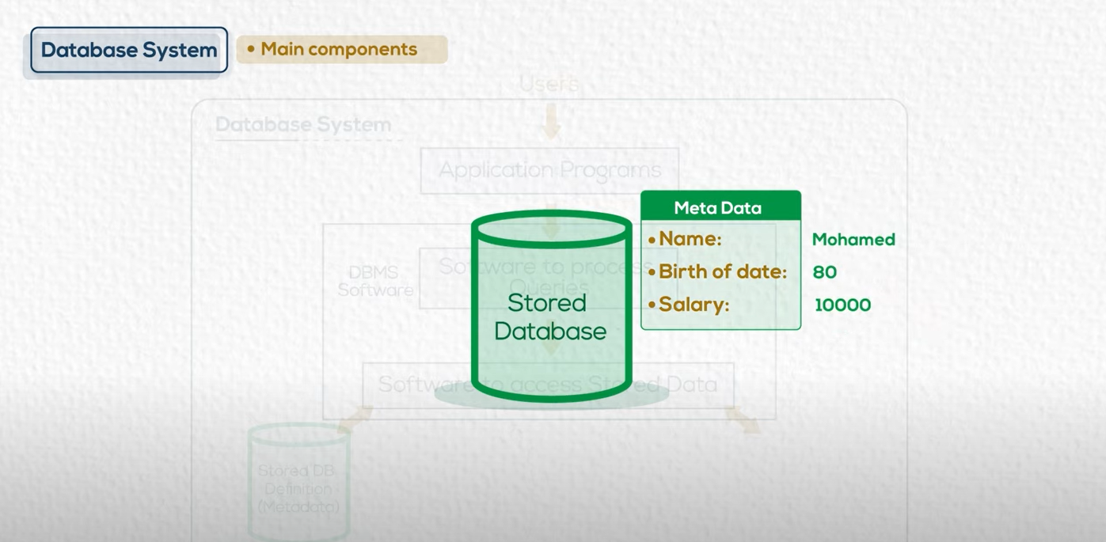

Slide 25
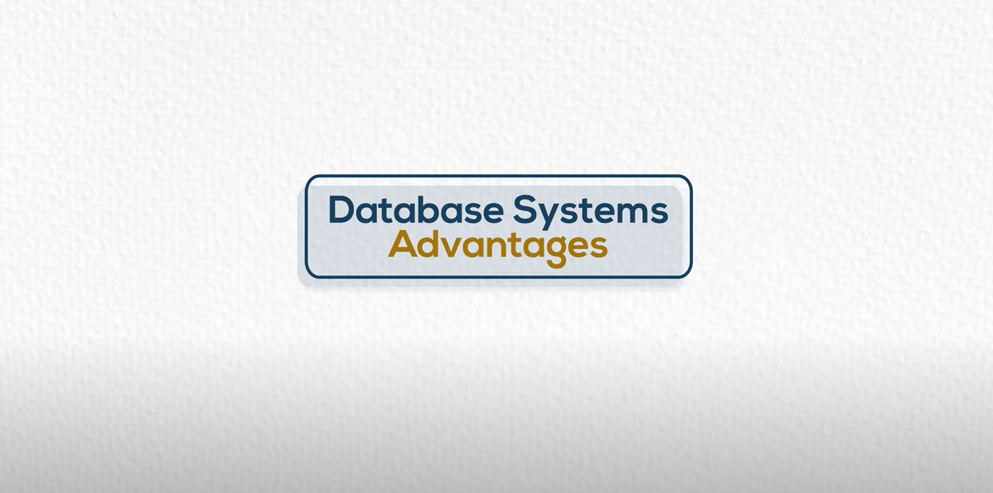

Slide 26
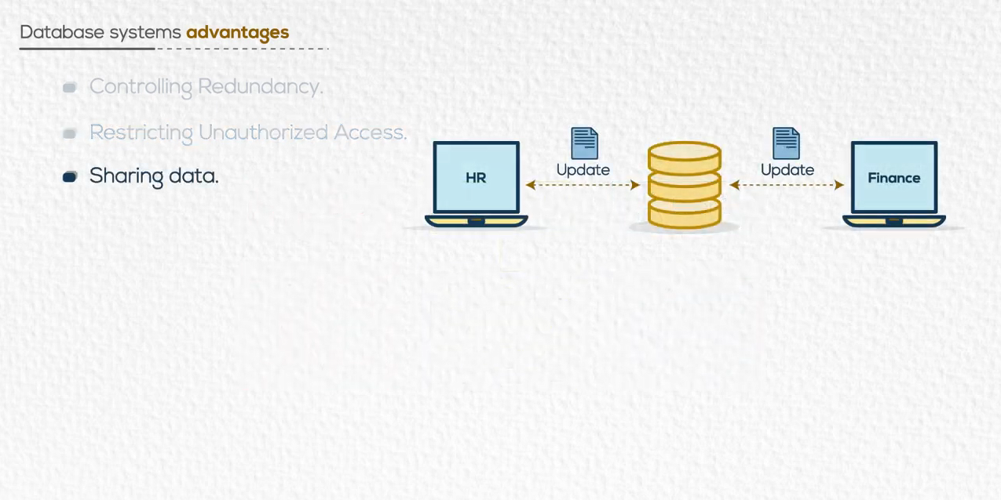
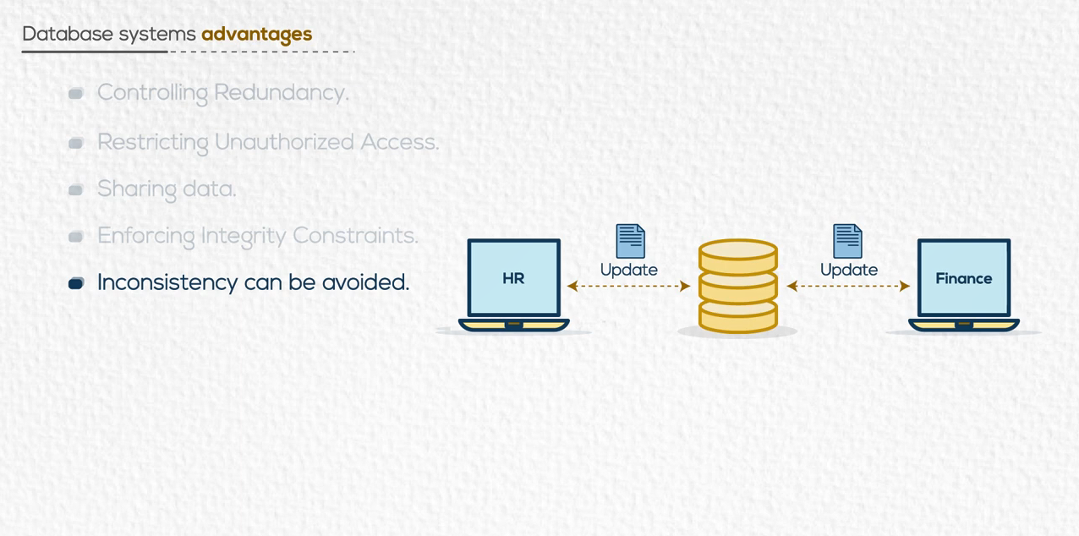
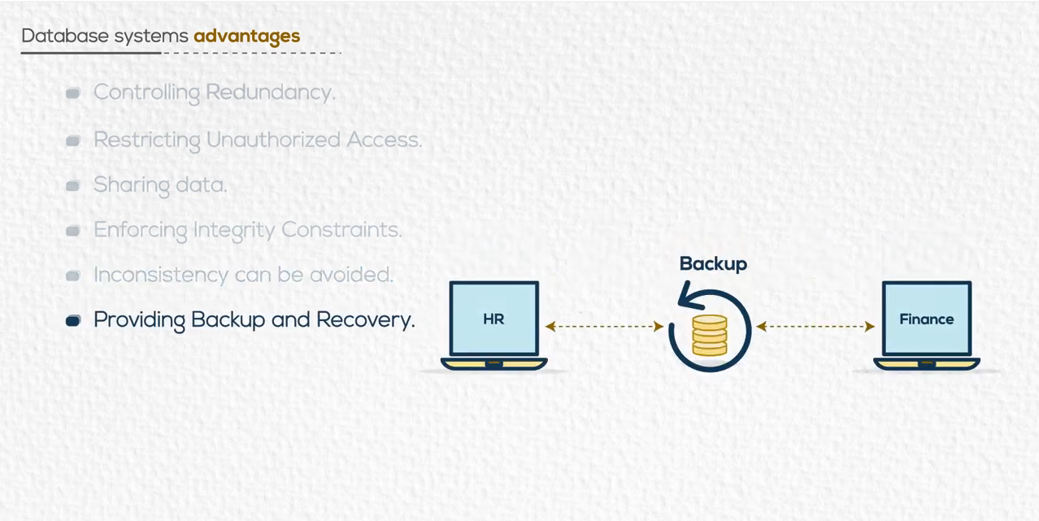
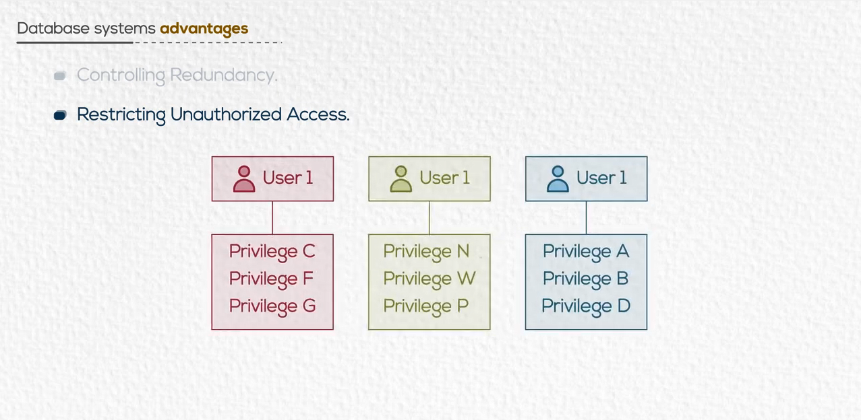
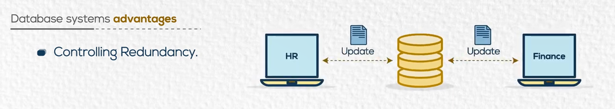
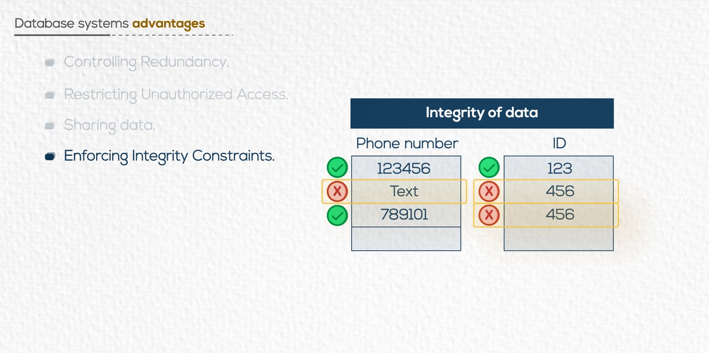
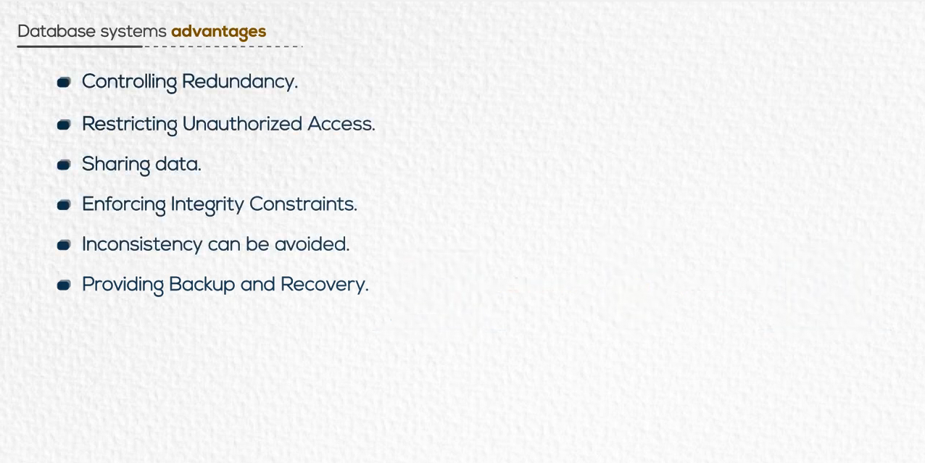
Apply Business Rules

Slide 27
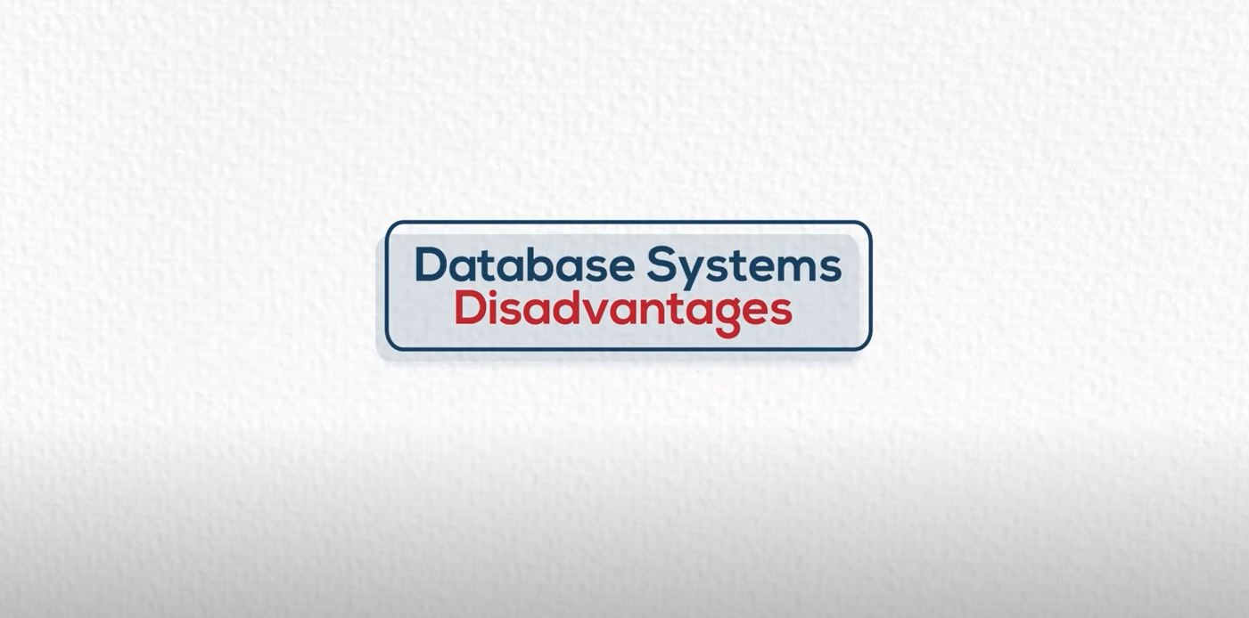

Slide 28
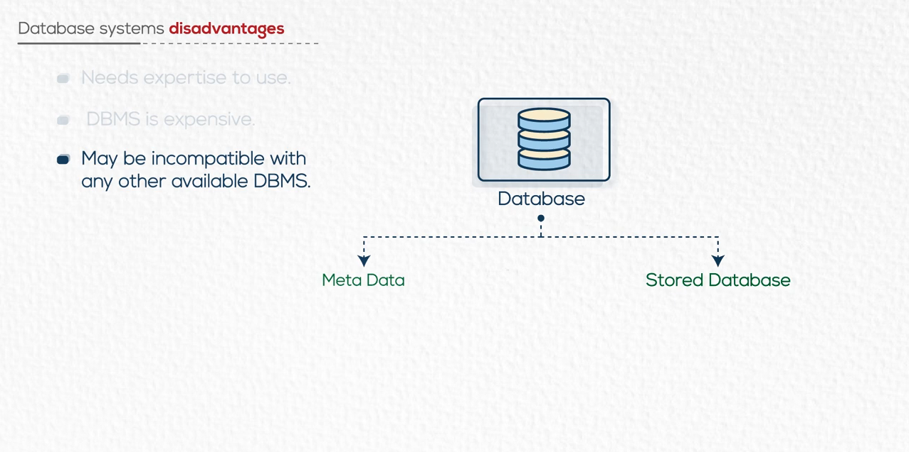
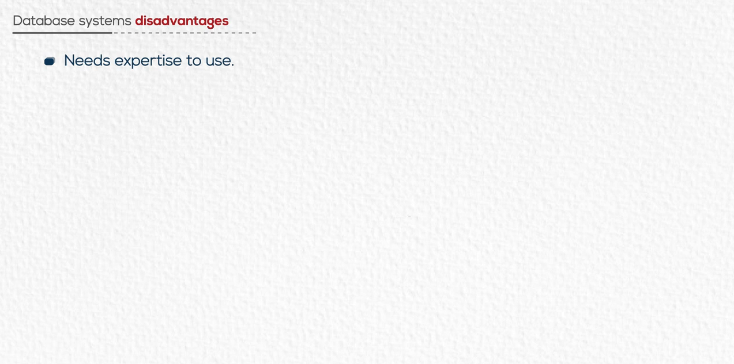
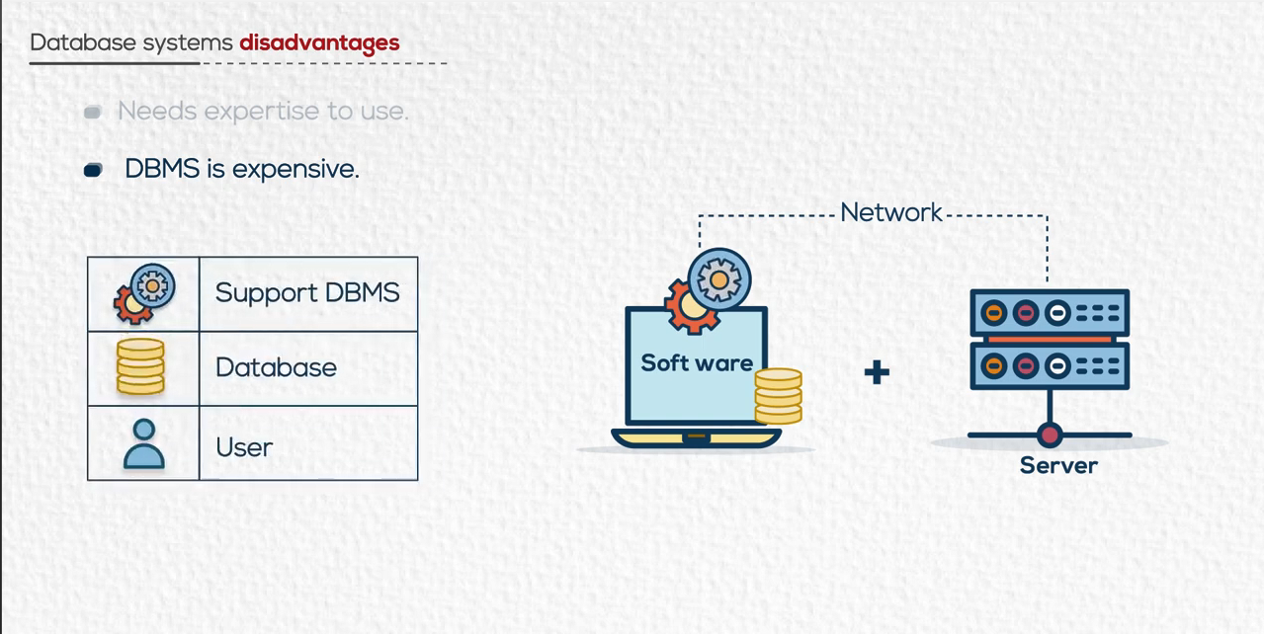


Example :

Slide 29
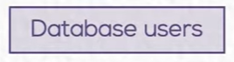

Slide 30
Cycle of Creating Database

Slide 31
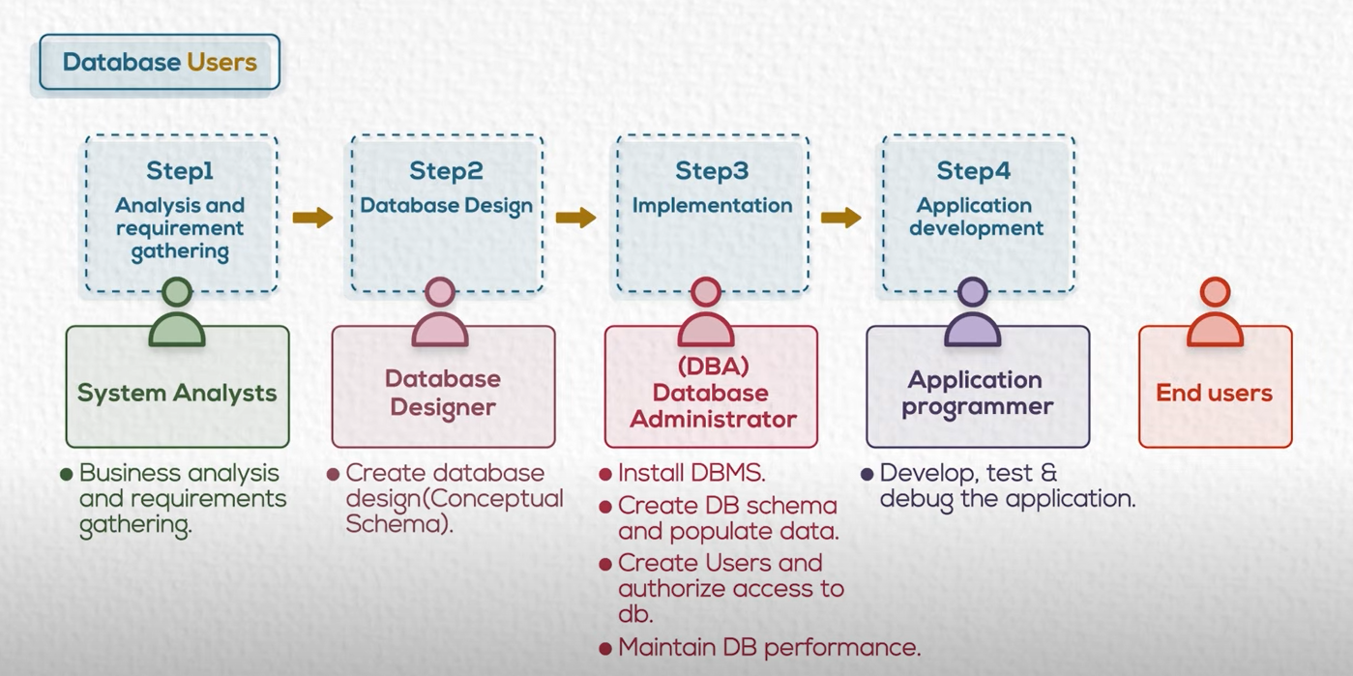
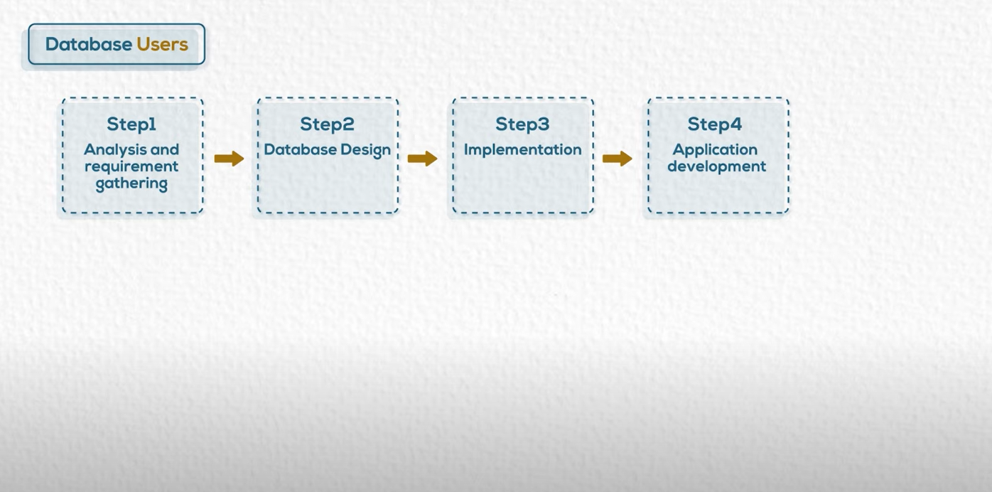

Slide 32
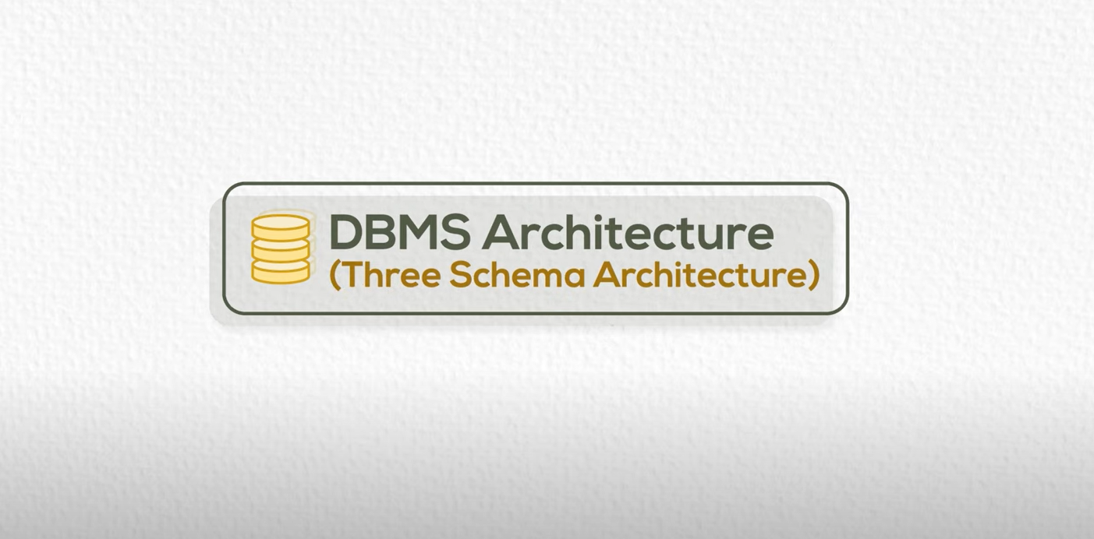

Slide 33
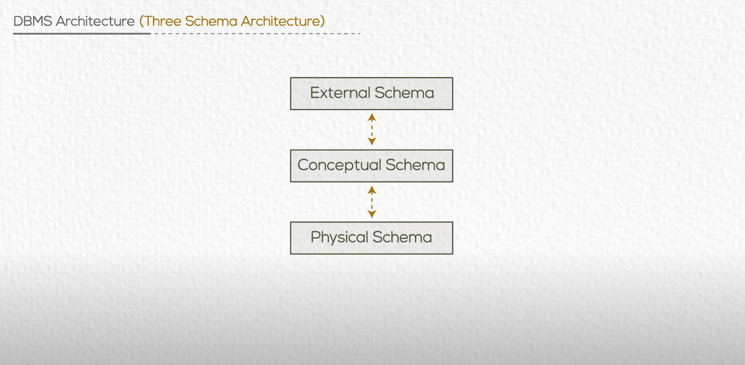

Slide 34
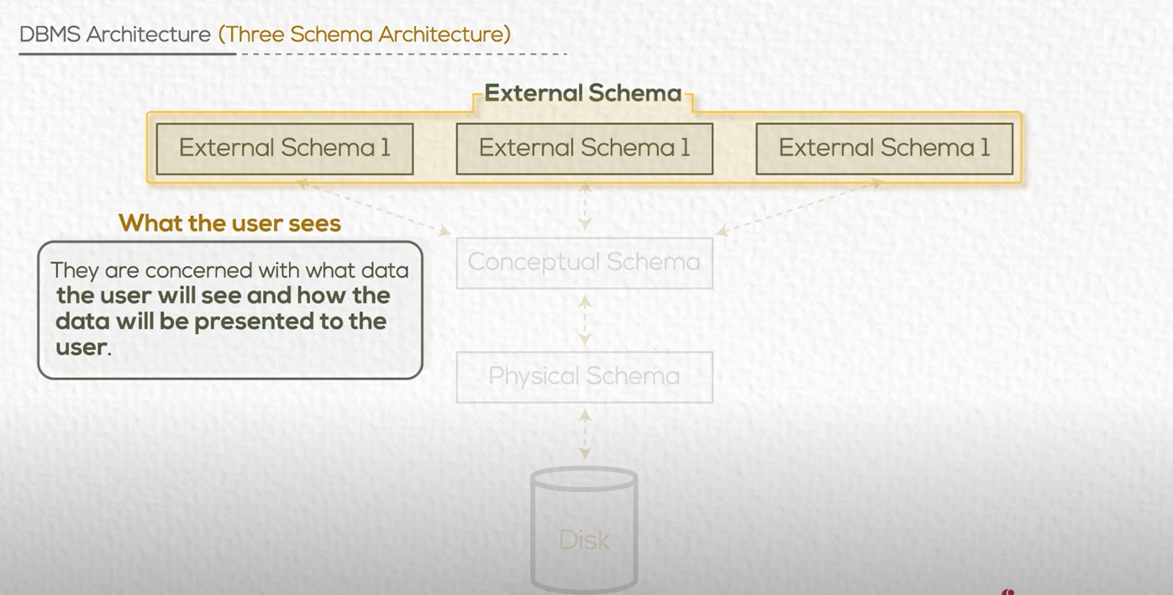
Ex: Financial Schema , HR Schema

Slide 35
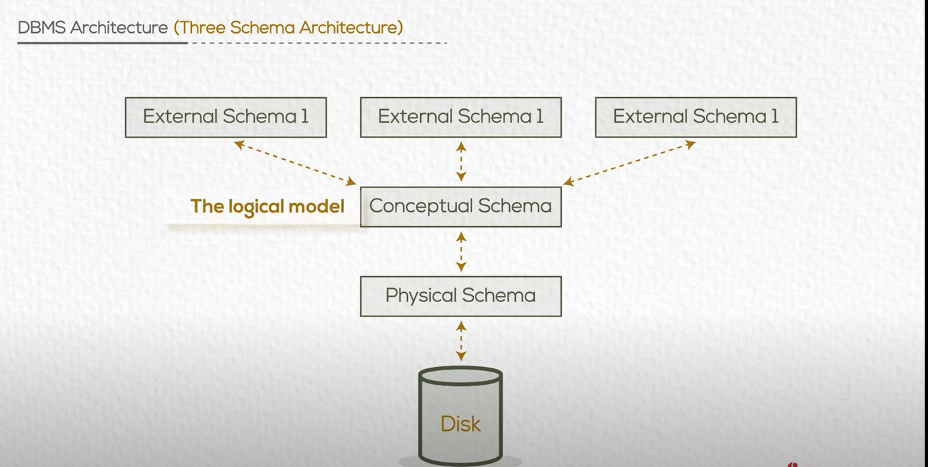

Slide 36
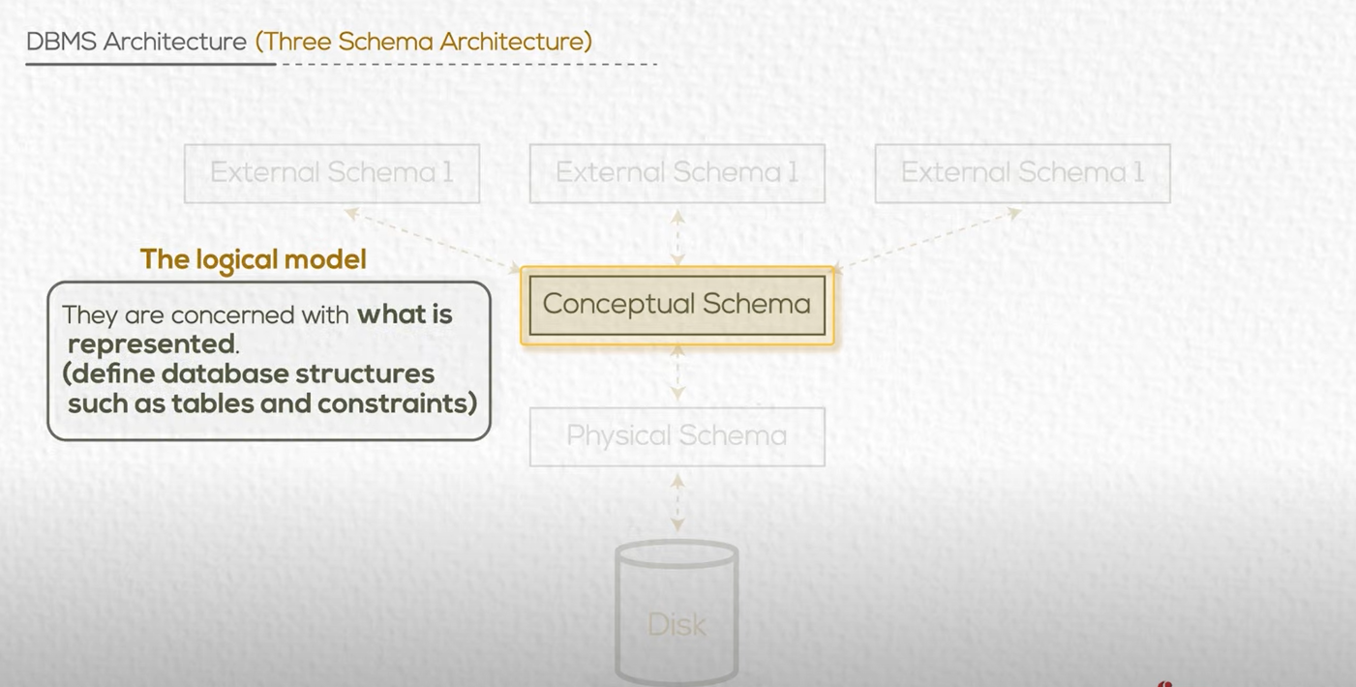

Slide 37
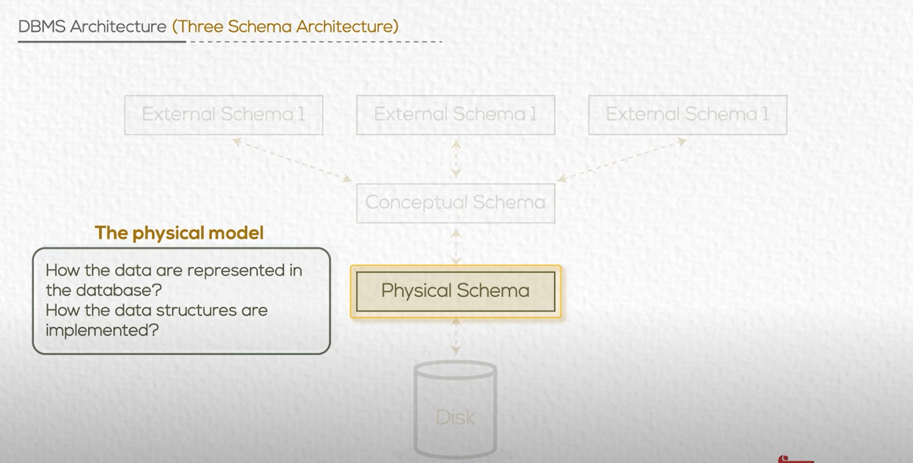

Slide 38
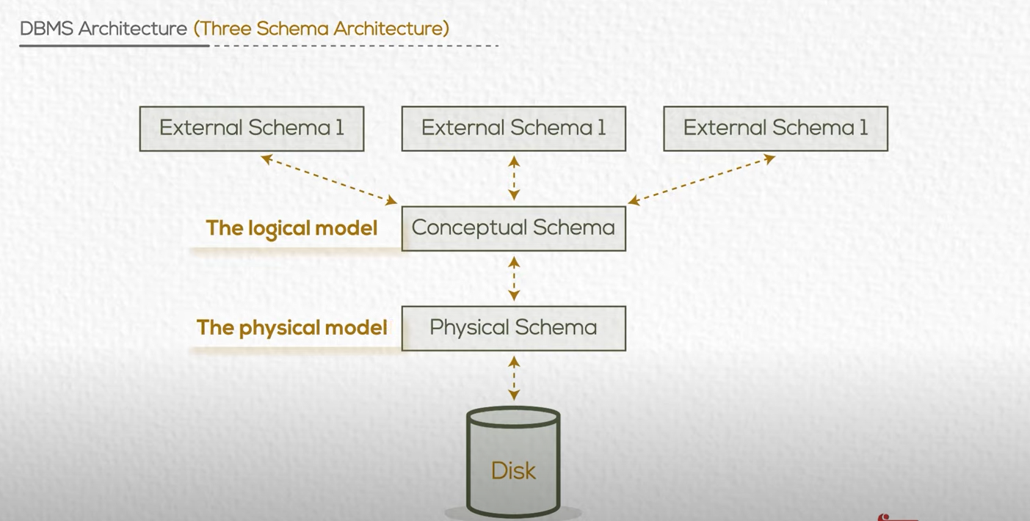
Why 3 schema? For data independence

Slide 39
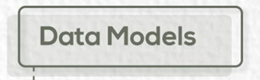

Slide 40
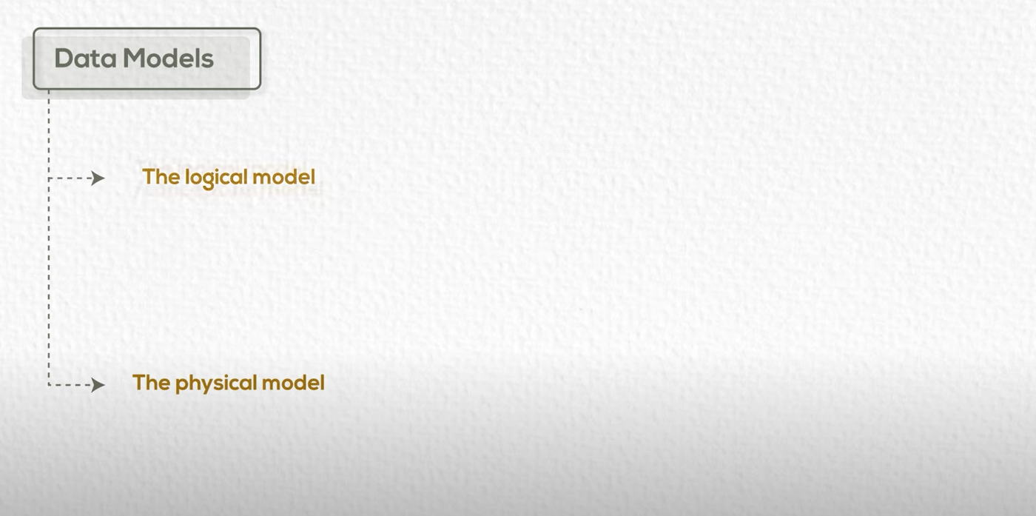

Slide 41
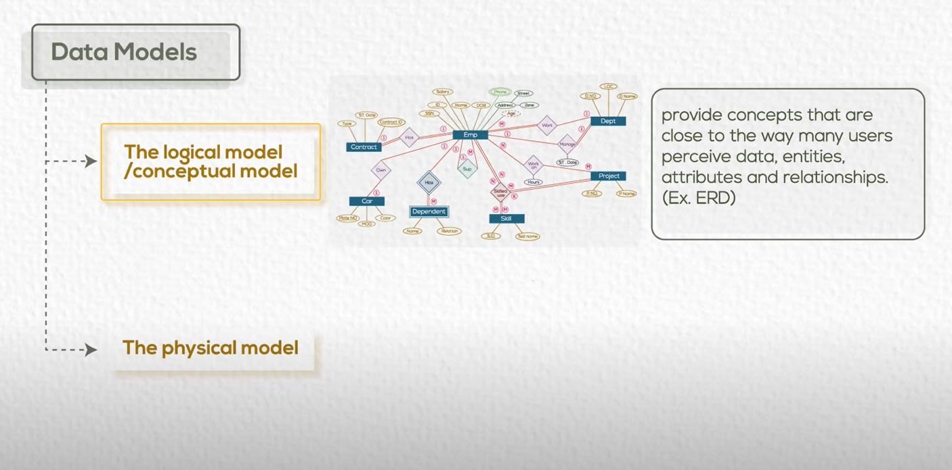
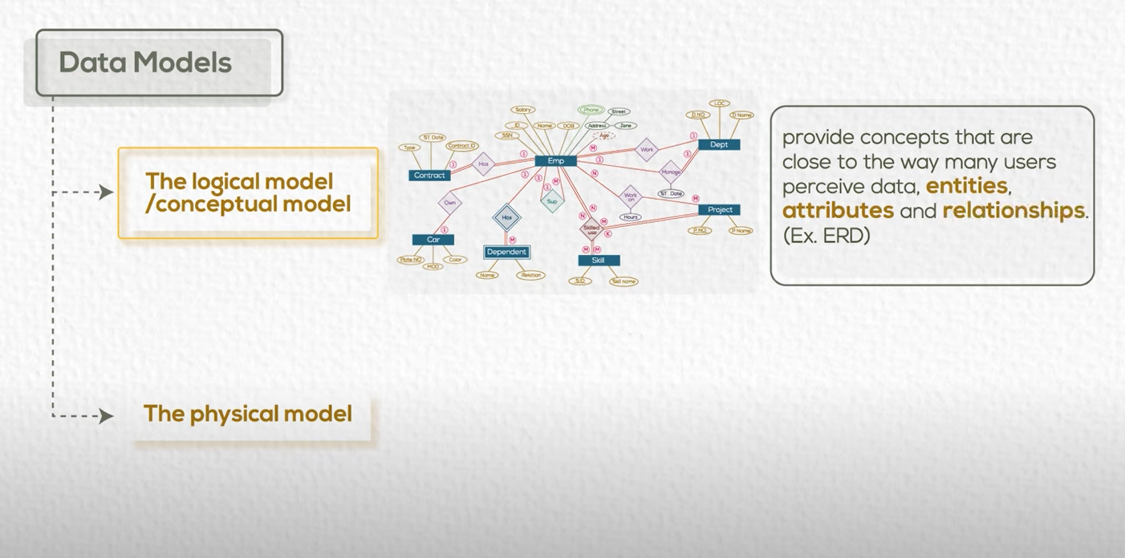

Slide 42
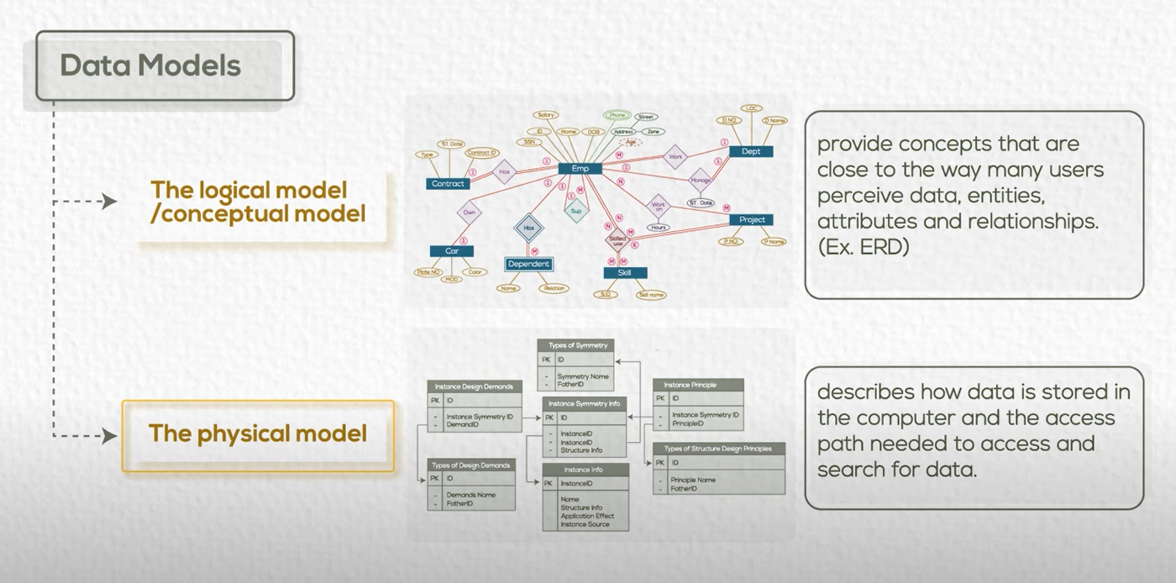

Slide 43
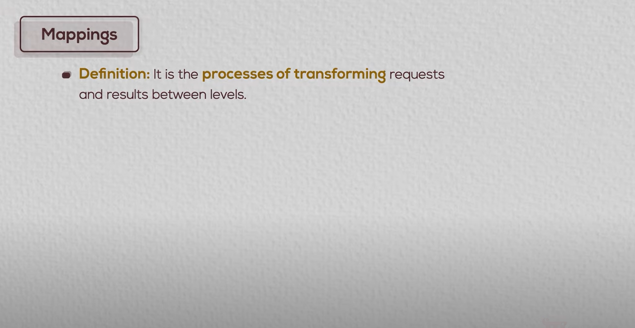

Slide 44
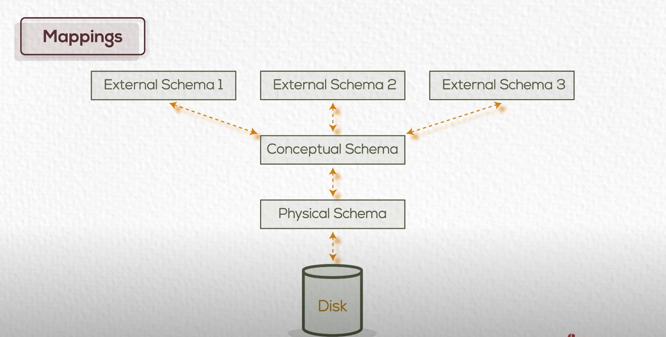



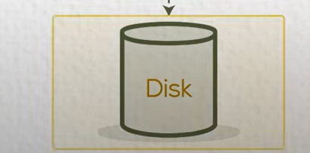

Slide 45
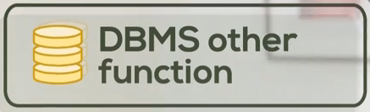

Slide 46


Slide 47

GIS

Slide 48

بيانات البورصة

Slide 49

Ex: classify users of supermarket

Slide 50


Slide 51


Slide 52

DB + App Server

Slide 53


Slide 54

(For App Update)

Slide 55


Slide 56

(For App Update)

Slide 57


Slide 58


Slide 59


Slide 60


Slide 61




Slide 62

columns
Records

Slide 63




Slide 64


Slide 65


Slide 66


Slide 67


Slide 68


Said Fawzy

